Slide 1
Financial Independence
During Difficult Time

Slide 2
Middle Income American Families Situation
25%
Debt
50%
House Hold
Expenses
25%
Taxes

Slide 3
What do Middle Income American Families Need?
College
Academic
Financial

Slide 4
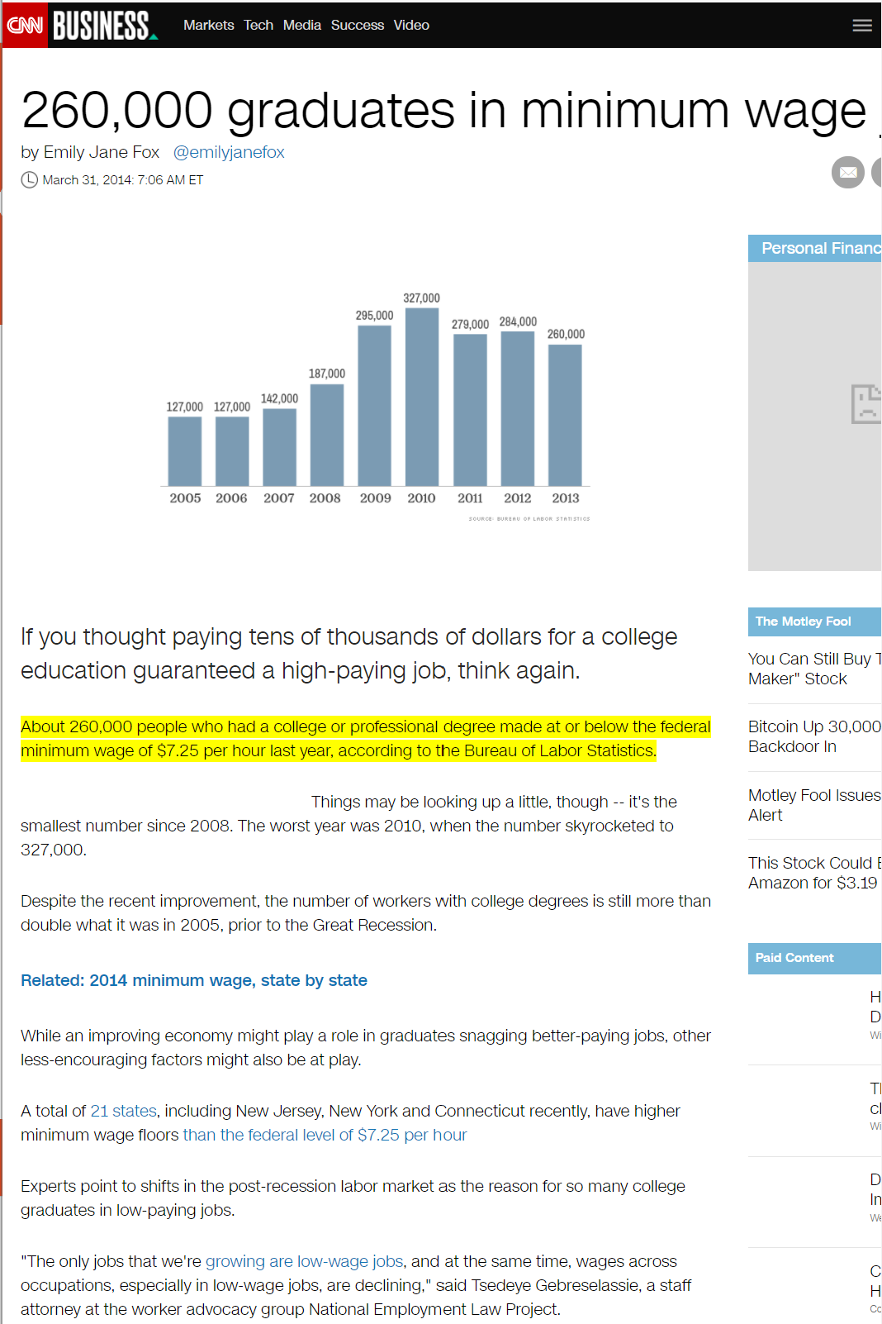


Challenges with College - Academic
About 260,000 people who had a college or professional degree made at or below the federal minimum wage of $7.25 per hour last year, according to the Bureau of Labor Statistics.

Slide 5

Heartland – Our Partner

Slide 6

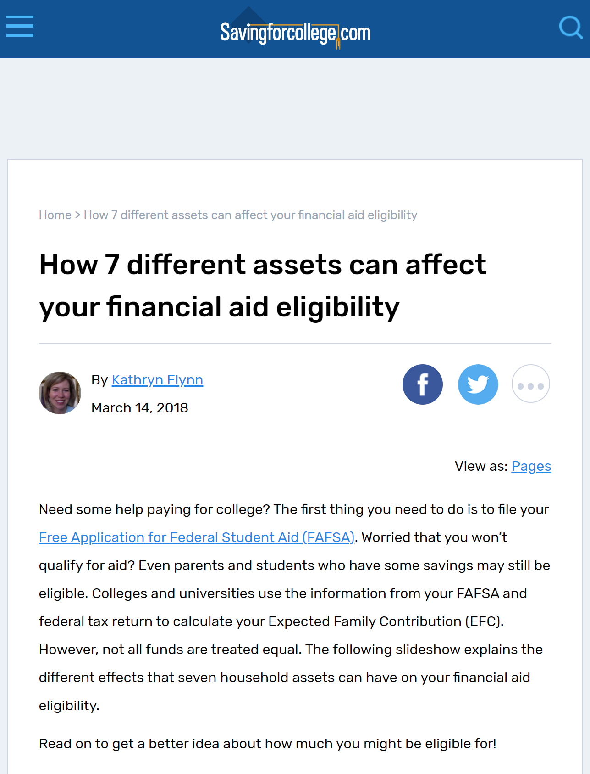

Challenges with College - Financial

Slide 7
What do Middle Income American Families Need?
College
Academic
Financial
Early Career
Savings Habit
Investment

Slide 8




Are You A Creature of Habit?
Clasp your hands together – which thumb is on top?
Cross your arms – which arm is on top?
Ladies – from which side of your mouth do you apply lipstick?
Men – from which side of your face do you start shaving?

Slide 9

Saving is a Habit, and so is Spending

Slide 10
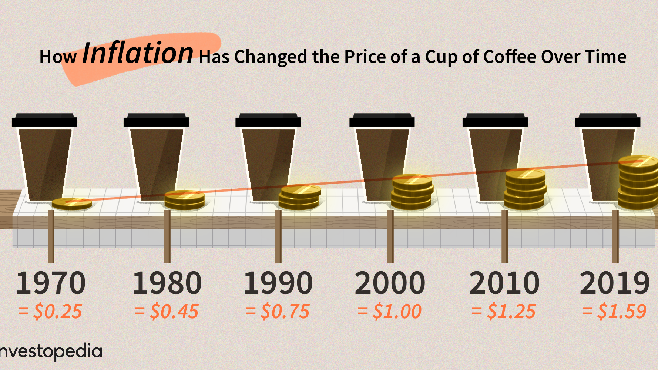
Saving and Investing - Inflation
3.5%

Slide 11
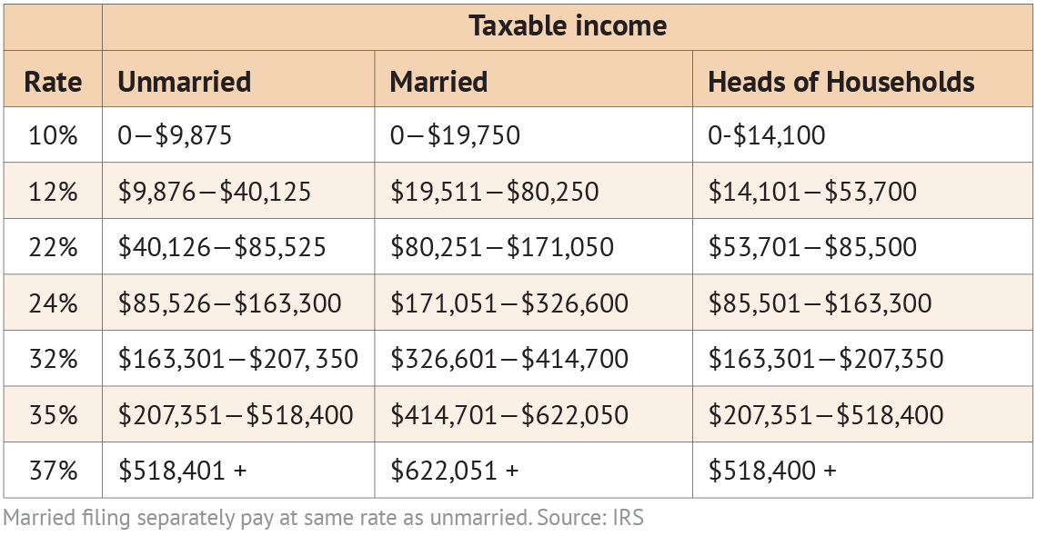
Saving and Investing - Taxes
22%
8%
------+
30%
Pennsylvania State Tax: 8%

Slide 12
How Much Do I Need to Gain?
Save | $100
Interest (5%) | + $5
Total | $105
Taxes (27%) | - $1.5
Net | $103.5
Inflation (3.5%) | - $3.5
Real Return | $100

Slide 13
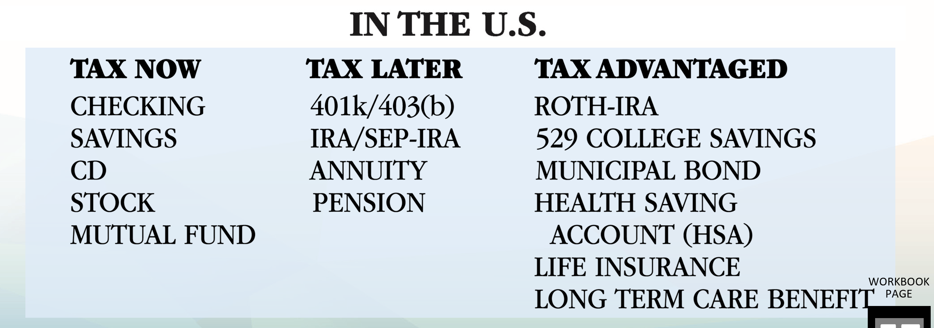
Do You Know the Different Tax Categories

Slide 14

Reduce the Impact of Taxes

Slide 15
What do Middle Income American Families Need?
College
Academic
Financial
Early Career
Savings Habit
Investment
Young Family
Protect Income

Slide 16
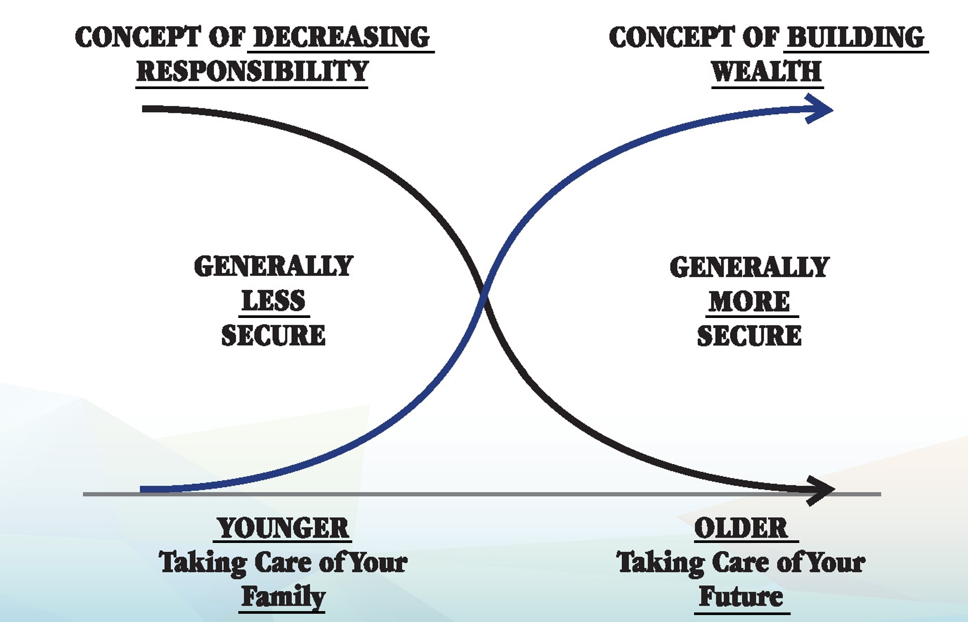
The X-Curve Concept

Slide 17
What do Middle Income American Families Need?
College
Academic
Financial
Early Career
Savings Habit
Investment
Young Family
Protect Income
Mature Family
Retirement Planning

Slide 18
How Much do We Need For Retirement
$1,000,000
20 years
x $50,000 =
65
85
86
87

Slide 19
What do Middle Income American Families Need?
College
Academic
Financial
Early Career
Savings Habit
Investment
Young Family
Protect Income
Mature Family
Retirement Planning
Retirement Phase
Longevity
Health Care
Long Term Care

Slide 20
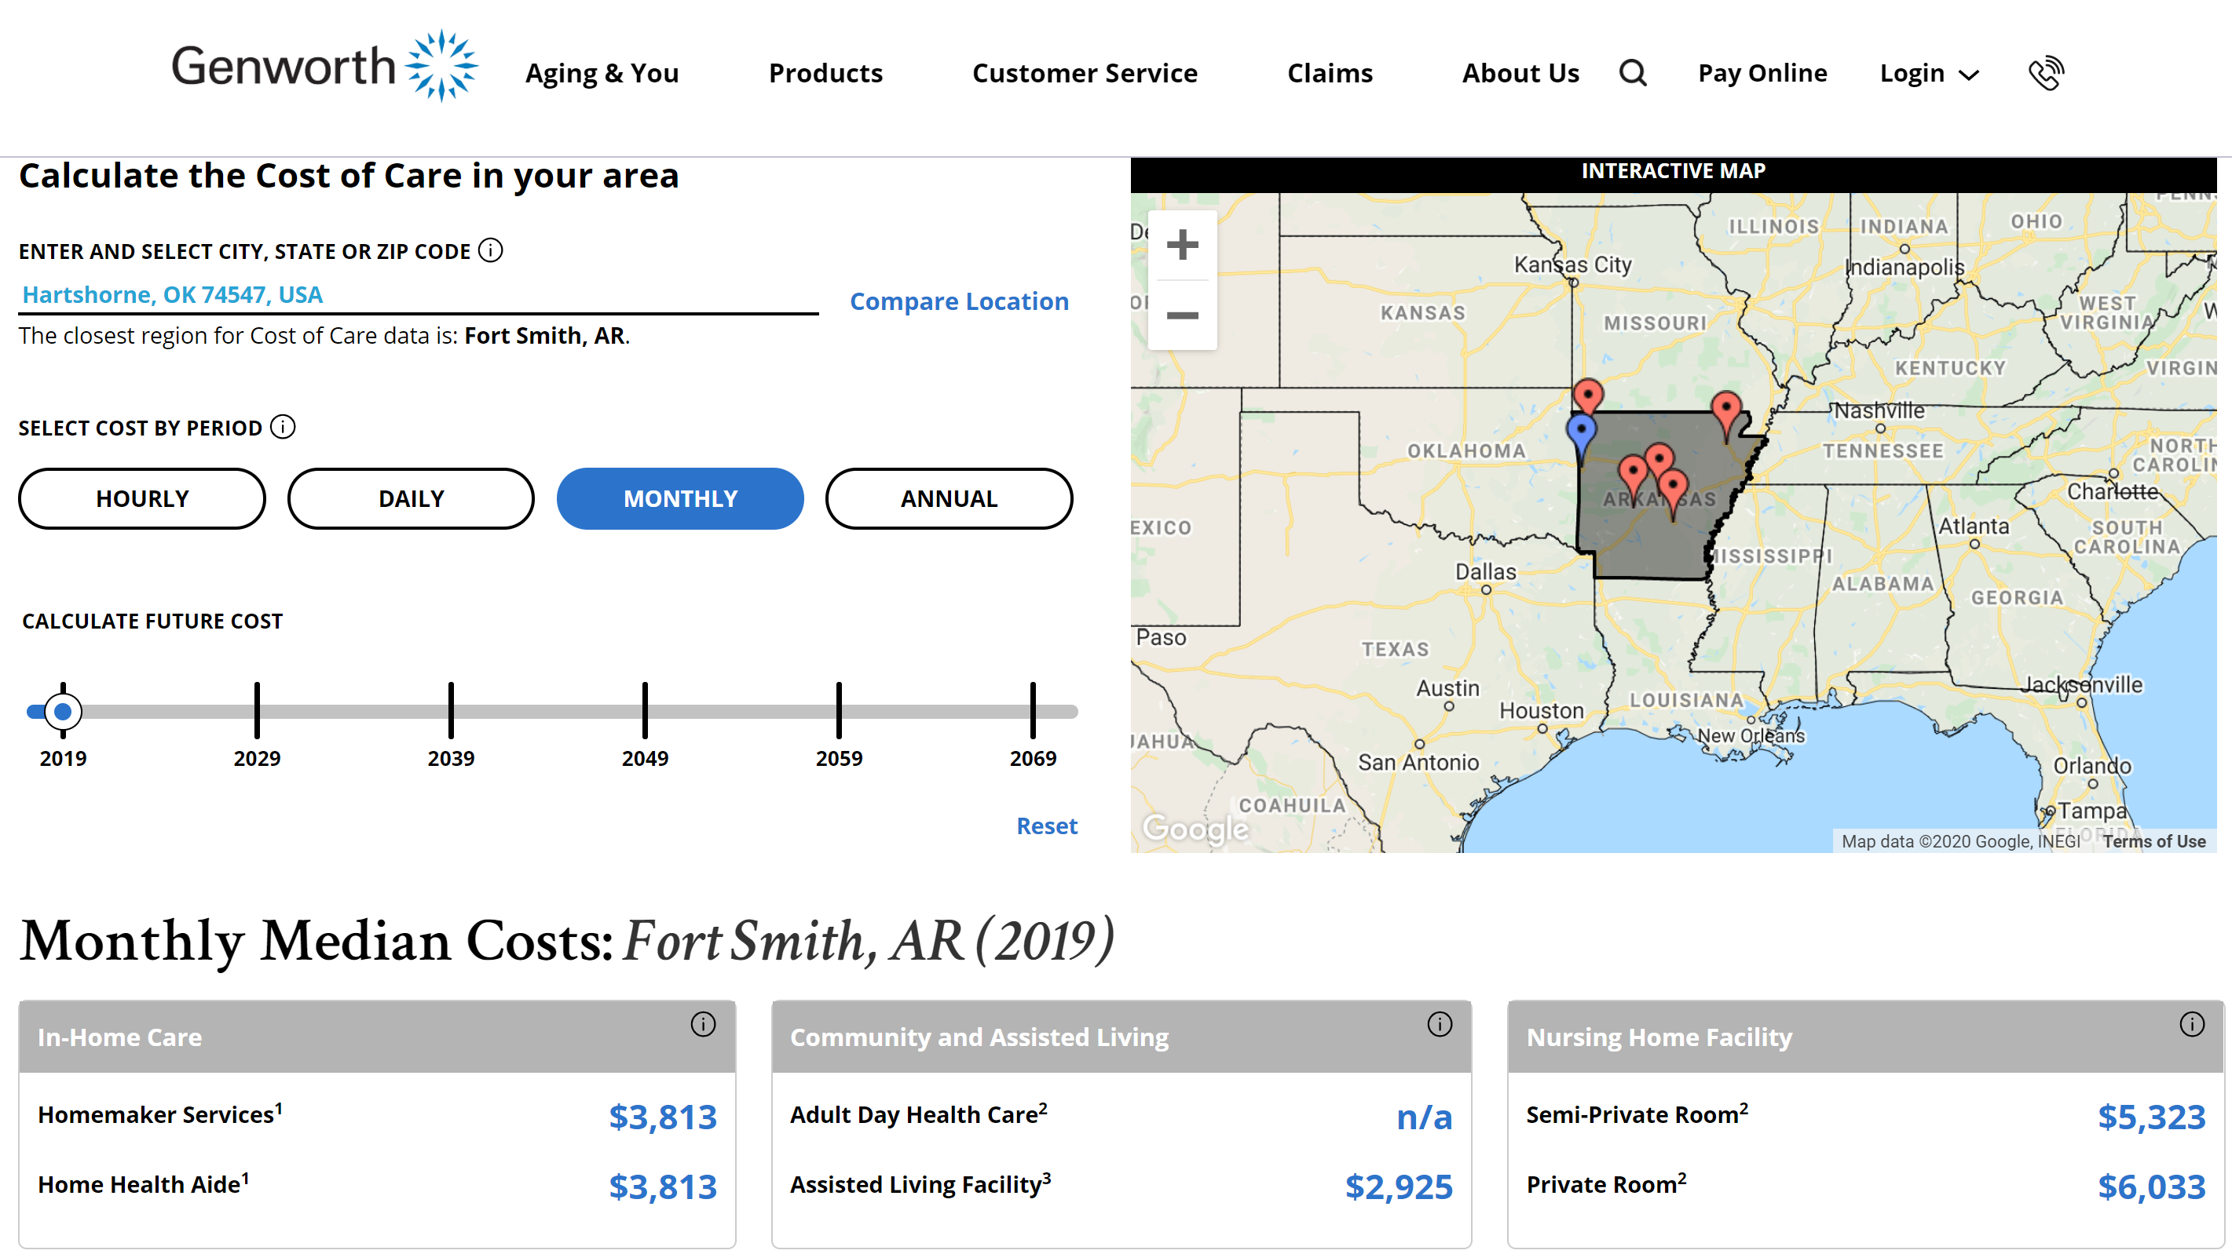
Cost of Long Term Care

Slide 21
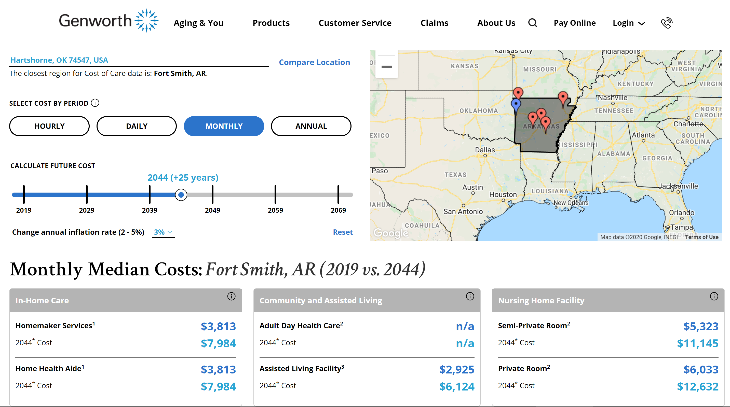
Cost of Long Term Care

Slide 22
What do Middle Income American Families Need?
College
Academic
Financial
Early Career
Savings Habit
Investment
Young Family
Protect Income
Mature Family
Retirement Planning
Retirement Phase
Longevity
Health Care
Long Term Care
Die
Estate Planning
Final Expense

Slide 23
Estate Planning
Will |  | To ensure my property will go to whom I choose when I die. Name Legal Guardian for Young Children
Trust |  | Avoid Probate => Expensive => 18 months Assign Successor Trustee(s) for Young Children
Advance Healthcare Directive |  | I don’t want to burden my family to have to try to make decisions for me
Power of Attorney |  | Trusted person to manage my accounts and finances if I’m unable to.

Slide 24
What do Middle Income American Families Need?
College
Academic
Financial
Early Career
Savings Habit
Investment
Young Family
Protect Income
Mature Family
Retirement Planning
Retirement Phase
Longevity
Health Care
Long Term Care
Die
Estate Planning
Final Expense

Slide 25
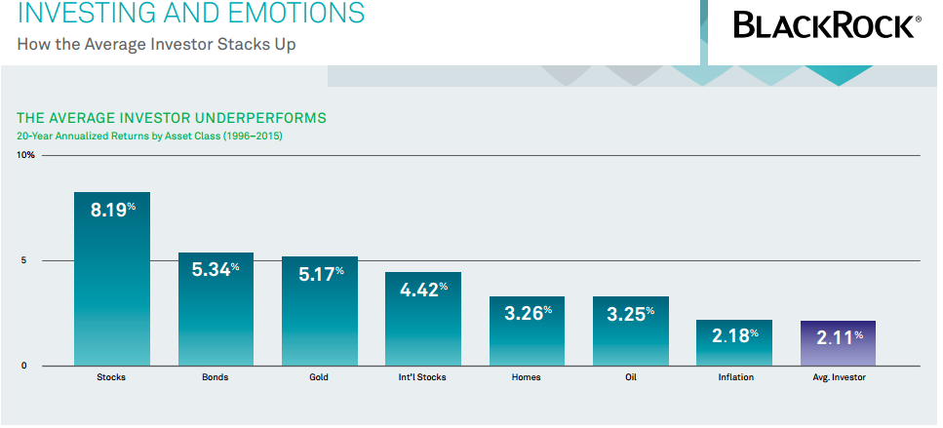

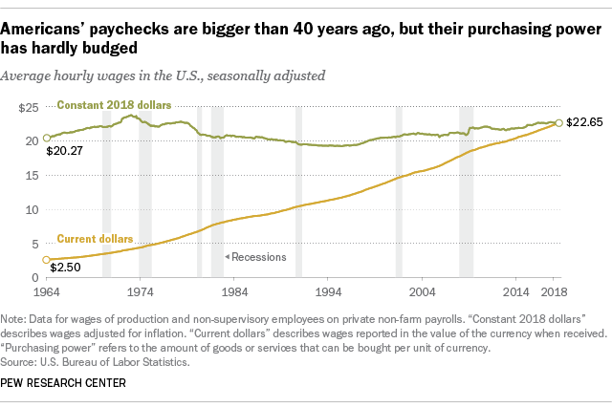
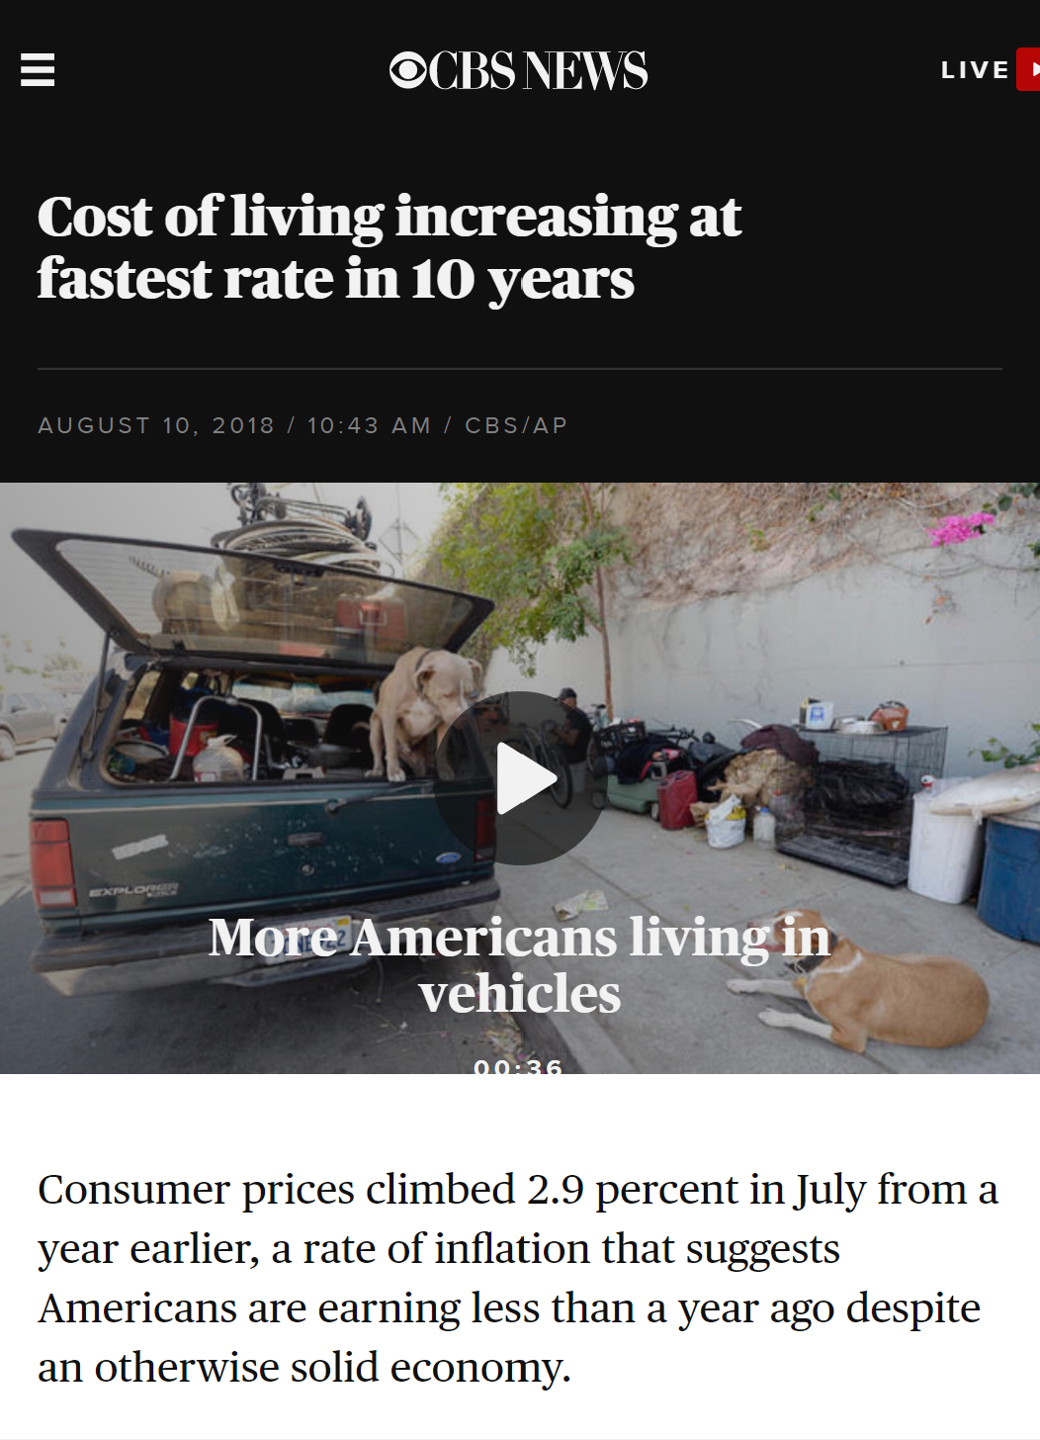
Middle Income American Family Challenge #1:
Not Enough $
High Tax
Slow Salary Raise
Lost $
And after refunds, the IRS collected about $93 billion more from individual American taxpayers than it did in 2017. Interestingly, that number stands close to the tax break amount that corporations received from the TCJA in 2018. Last year, big businesses paid $91 billion less in taxes than they had in 2017, prior to the new law’s passage.
Cost of Living
2.11%
1964
$20.27
2018
$22.65

Slide 26






Middle Income American Family Challenge #2:
$ Demand High
Emergency $
Retirement $$$$
Mortgage $$
Protection $$$
College $$$
Estate
Preservation $$

Slide 27

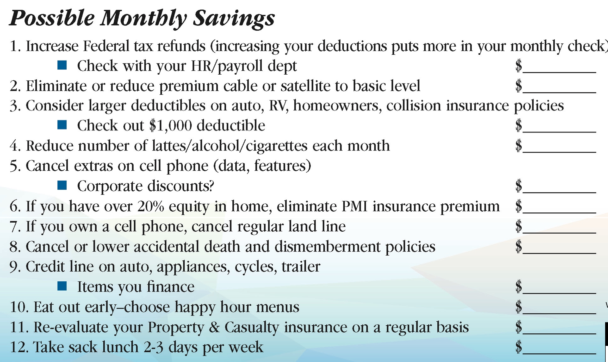

How do I Get Started to Financial Independence?

Slide 28
Build a Strong Financial Foundation
Investment
Debt Mgmt
Protect Income
Emergency Fund

Slide 29
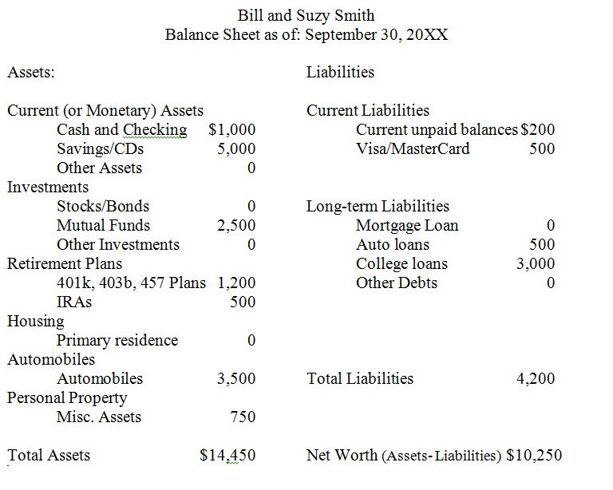

How do I get Started?
Investment
Debt Mgmt
Protect Income
Emergency Fund

Slide 30
Q & A

